Slide 1


Code Challenge GIC ISPVMF Global Retreat 2017
Notes:
E1 - Good Morning, Welcome to the first day of the ISMPVMF retreat and an interesting segment – The programming challenge. I am <> and I am <>.
E2 – Are you sure you are in the right place – this is not a TD retreat, what is programming doing here? It’s ISPVMF retreat
E1 – Yes yes, I know it’s quite unusual, but this is very much for this fantastic group of ISPVMF.
You may think today’s session is a lesson on programming. But no, this is about playing a team game and challenging your colleagues to win some exciting prizes – and along the way picking up some useful programming skills. There is no programming skill or prior experience needed, and each one of us can participate. The basics of programming will be weaved into challenges through some fun tools, to expose the logic and analytical thinking process behind it.

Slide 2
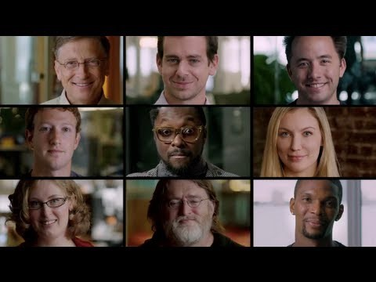
Yup, Everyone Can Code!
Notes:
(Pre-video) Now here’s a short video featuring people from diverse backgrounds like sports, musicians, CEOs, etc. sharing about programming.
(Post-video) This video demonstrates the simple point that everybody can and should learn programming. Today’s session is about giving you a start on this journey.

Slide 3
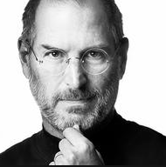
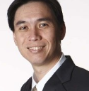
“
Everybody in this country should learn how to program a computer…because it teaches you how to think.
- Steve Jobs
”
“
The core skills that programing brings out in every one of us is logical/analytical thinking and the ability to solve problems in a creative manner.
- Hoe Yin
”
Notes:
The famous Steve Jobs once said:…
The equally famous personality in GIC circles has said….
So let’s look forward to a fun-filled session to gain some handy coding skills which has a potential to blossom into a core skill for you to be Future Ready in the tech-driven business model.

Slide 4

Aim
Basic
Introduction
To Coding
- Basic Python
- Web scraping
Most Importantly
Get to
Know
One
Another Better

Slide 5
Plans
Appetiser
11:15-11:30 - Introduction
11:30-12:30 - Baby Python
12:30-1:00 - Lunch Break
Main Course
1:00-1:30 – Say Hello to ReBot
1:30-2:30 – Taming the Python
2:30-4:00 – Rebot Challenge
4:00-4:30 – Short Break
Dessert
4:30-5:15 – Idea Generation and Pitch preparation
5:15-5:30 – Move to 38 Auditorium
5:30-6:15 – Pitch, Awards and Closing
Notes:
Here’s the agenda for today

Slide 6
Get Ready!

Slide 7
Why Code?
10 minutes
Notes:
Good morning Everyone.
I am <> and I am <>.
We are excited to be here with you and provide you a fun journey
Some of you may be

Slide 8




Notes:
RPA, automation, data
Not to turn everyone into programmers – basic understanding, possibilities
GIC use cases at the end

Slide 9
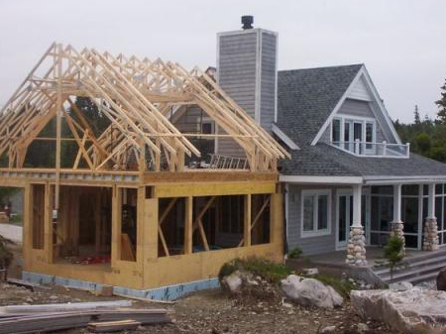
Notes:
Owner’s Mentality. Agile’s Project Owners
If someone wants to do renovation on your house, would you want to leave it with the person for 6 months? Or would you want to know exactly what the builder is going to change?

Slide 10
Stop. Think of Logical Blocks
Let’s get a computer to do things.
But,
The machine is a fast worker but very stupid
“Please, make me a sandwich!”
Will this work?
Step 1: Take a slice of bread, put it on the board
Step 2: Apply a 1mm layer of butter on the bread
Step 3: Take a slice of ham, put it on the bread
Probably closer to this,
Step 1: Move arm to coordinates (49, 50, 0) with power 1W
Step 2: Move arm down to (49, 50, -40) with power 1W
Step 3: Tighten fingers with power 2W
Notes:
Process of breaking down problems
Practice of breaking logic into a set of instructional processes
Improves logical thinking by breaking a problem into a set of

Slide 11
Python?
Uh.. Eating a snake?
45 minutes
Notes:
5 min - Opening vid
15 min: Intro & context
40 min: Scratch
30 min: Python
5 min: Code & Algorithms
15 min: Use Cases x2
5 min: Wrap up

Slide 12
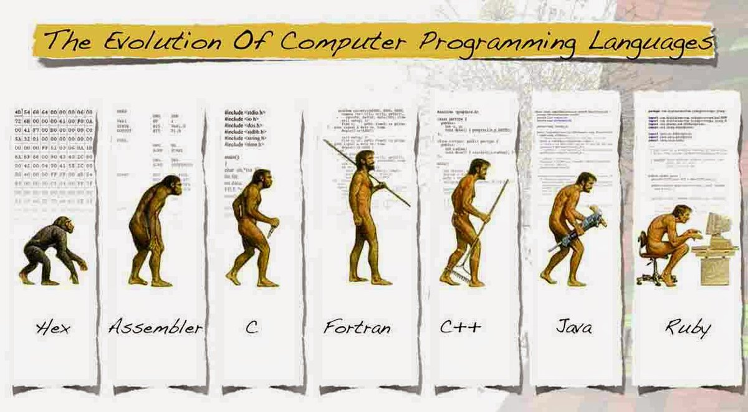
What Exactly is Python?
Considered a Fourth Generation Language
Simple & mighty for mathematical libraries
Relatively “natural” to read
Python!
Notes:
[Probably need a better picture for this]

Slide 13
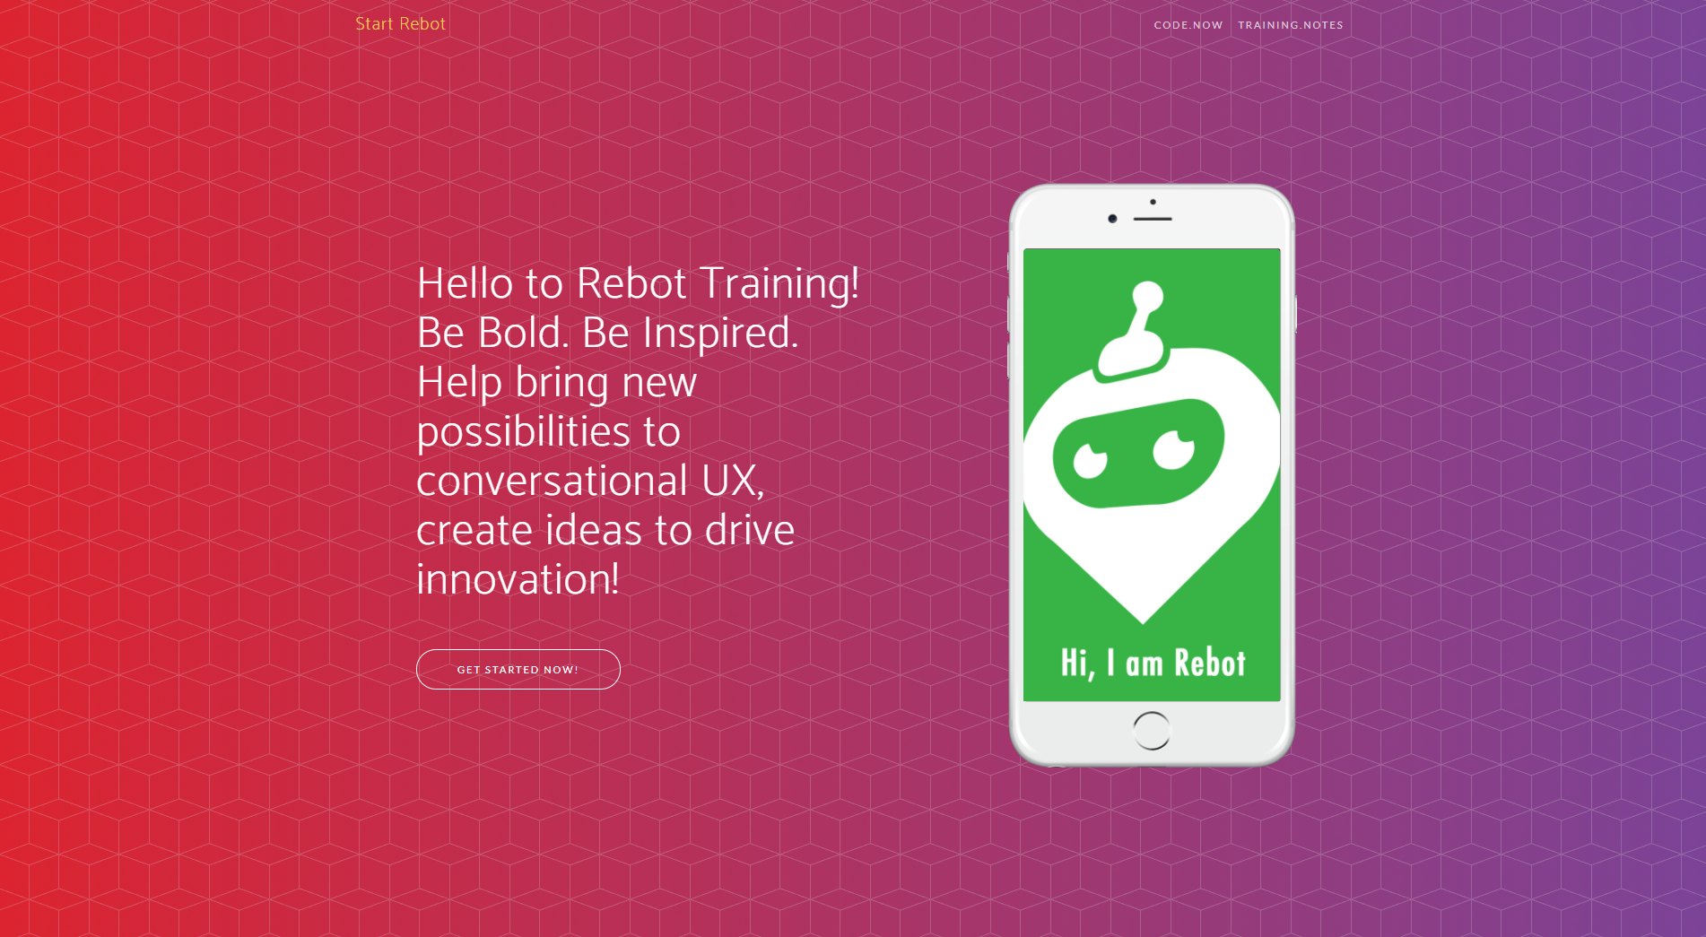
Visit Rebot.Chat
Type rebot.chat in your web browser

Slide 14
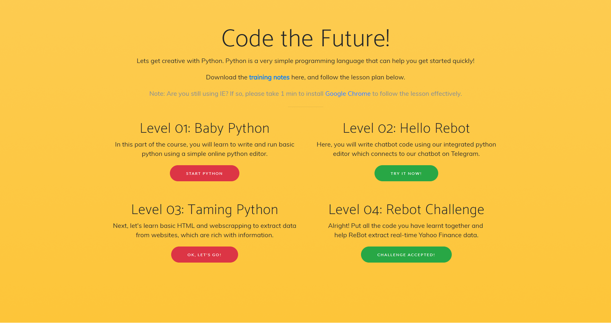
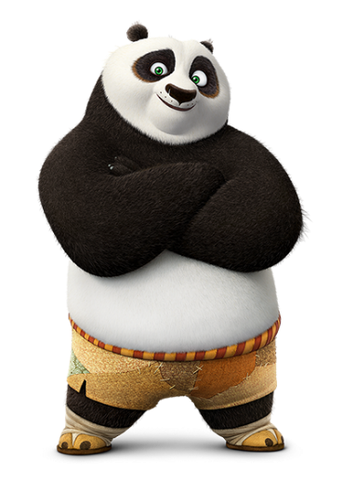

Slide 15
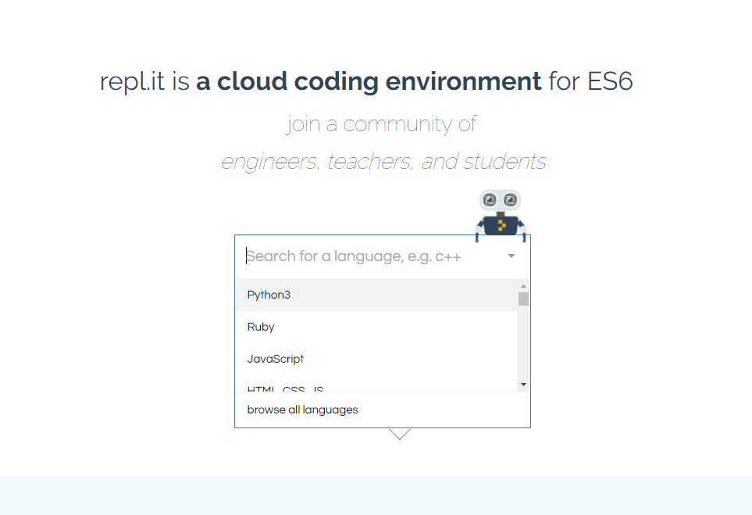
REPL: Basic Online Python Editor
Select “Python3”

Slide 16
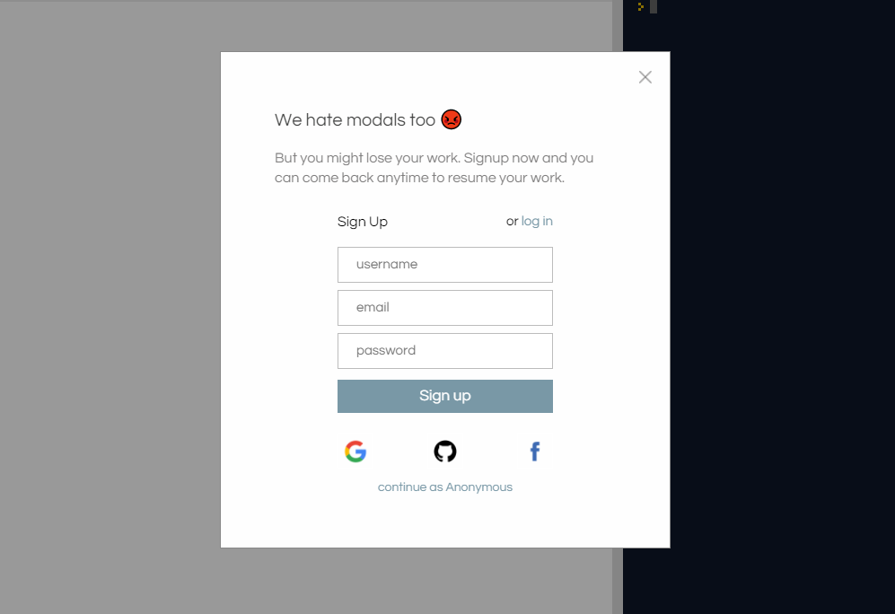
REPL: Basic Online Python Editor
Select “Continue as Anonymous”

Slide 17
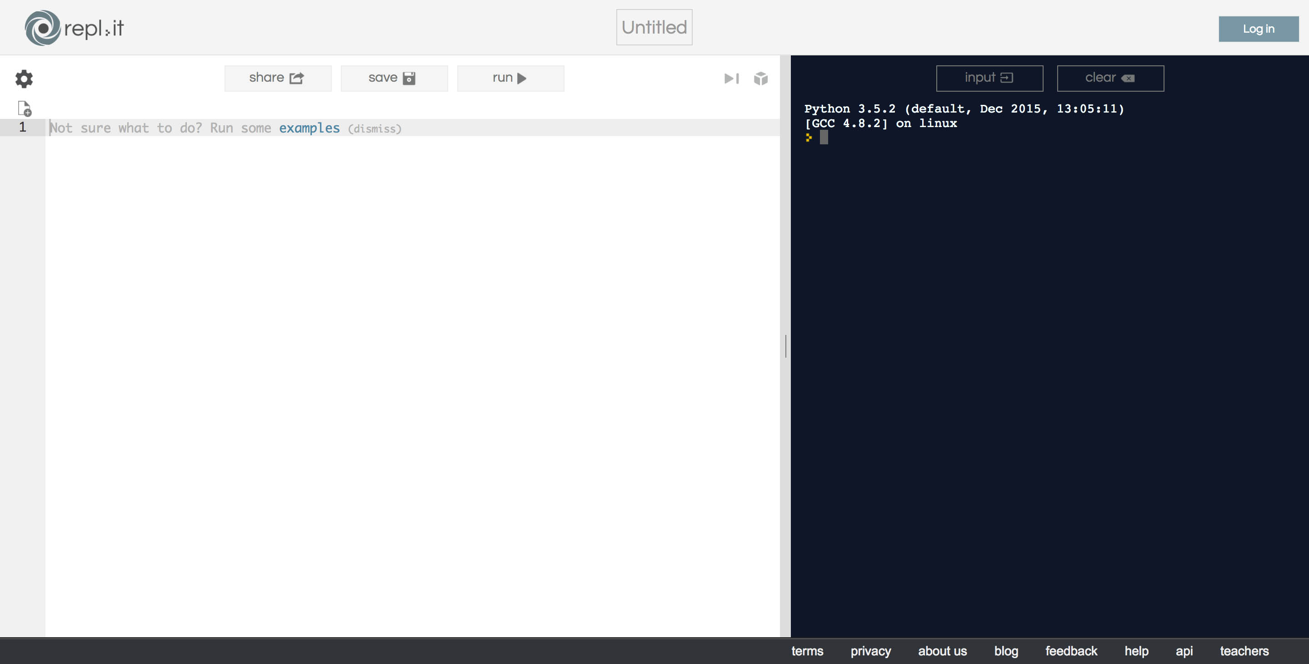
REPL: Basic Online Python Editor
(Left-Hand Side)
Write code here
(Right-Hand Side)
See output here
Notes:
Online editor

Slide 18
REPL: Basic Online Python Editor
Run your code
Save your changes
Notes:
Online editor

Slide 19
Real Code! Step-by-Step
Appetizer
Print “Hello World”
Explain concept of variables (containers)
Create a string variable “name”
Print “Hello, my name is …”
Main Course
Try addition, multiplication, division, subtraction
QN: what is 1 + 1?
Concept of variable types - integers, string etc.
Concept of (IF .. THEN .. ELSE)
Dessert
Recap + Free-to-play
Notes:
See trainer-guide – Level 01

Slide 20
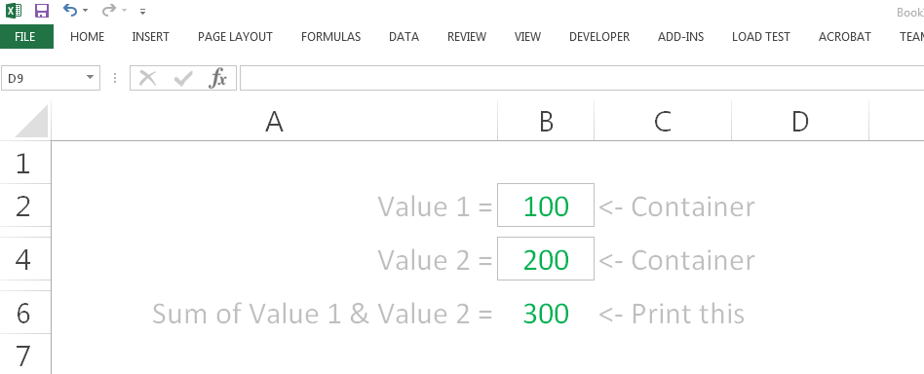
Hey wait, isn’t this familiar?
Excel Formulas
Describe outcome with expressions
Cell = IF(SUM(A:A) > 1, SUM(A:A), “No”)
Excel Worksheet Cells
Think of “Cells” like “Containers”
I am an Excel Worksheet
Notes:
Bring audience back to their daily work. Excel that they are familiar with.
So they could already have been doing this unknowingly.

Slide 21
Logical Design >> Code
Coding easy to learn (And, can be fun ☺)
Writing a recipes: EASY
Creating a recipe: HARD
Given set of values: 5, 9, 10, 4, 11, 3, 6
Highest and lowest number?
What’s your recipe?
Don’t just translate your work procedures to code.
Simplify and refine it.
Notes:
Not the code that is important. The Logic is the critical part

Slide 22

Golden Quotes
“
The core skills that programing brings out in every one of us is logical/analytical thinking and the ability to solve problems in a creative manner
- Hoe Yin
”
Notes:
The famous Steve Jobs once said:…
The equally famous personality in GIC circles has said….
So let’s look forward to a fun-filled session to gain some handy coding skills which has a potential to blossom into a core skill for you to be Future Ready in the tech-driven business model.

Slide 23
Lunch-Break
12.30pm – 1.00pm
30 minutes

Slide 24
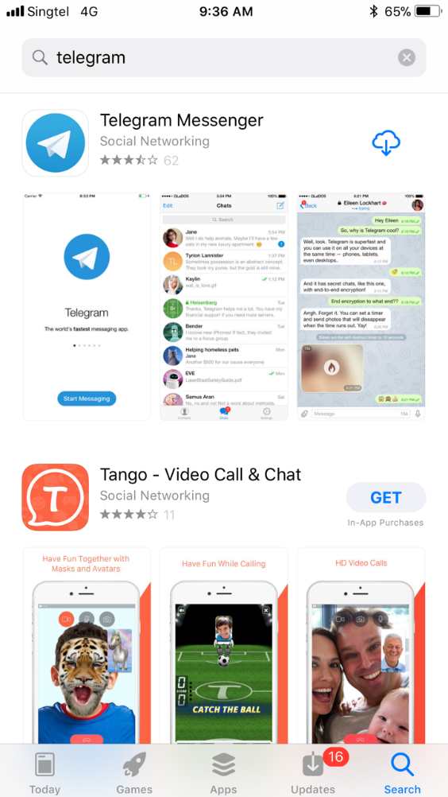





Step 1: Install Telegram

Slide 25
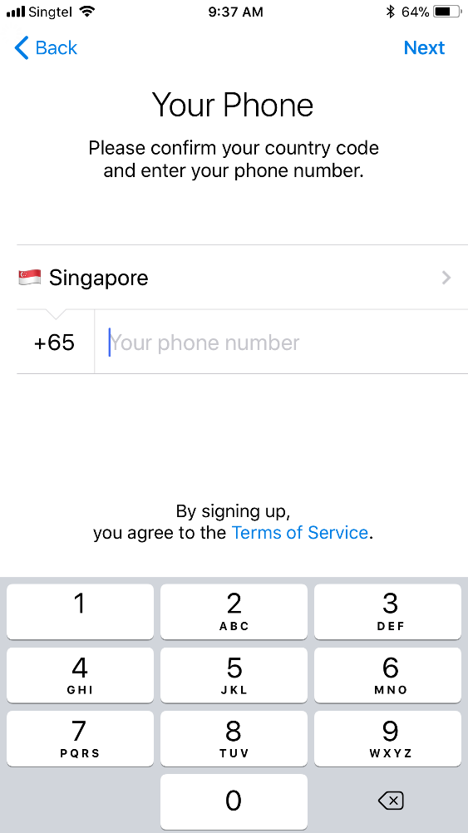
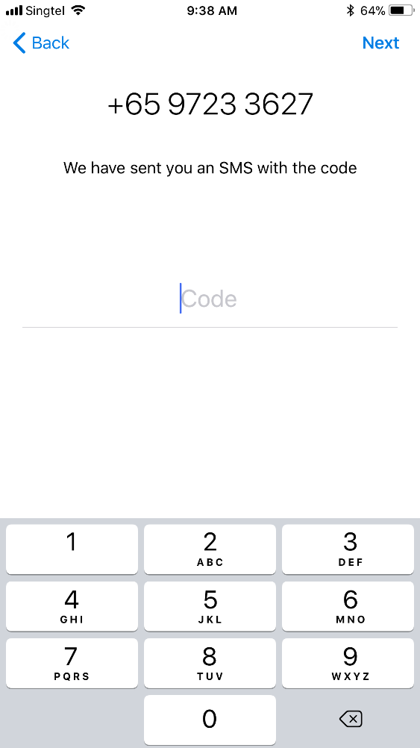
Step 2: Register Account
Register for an account
Wait for an SMS passcode
Key in the passcode
Your Phone Number

Slide 26
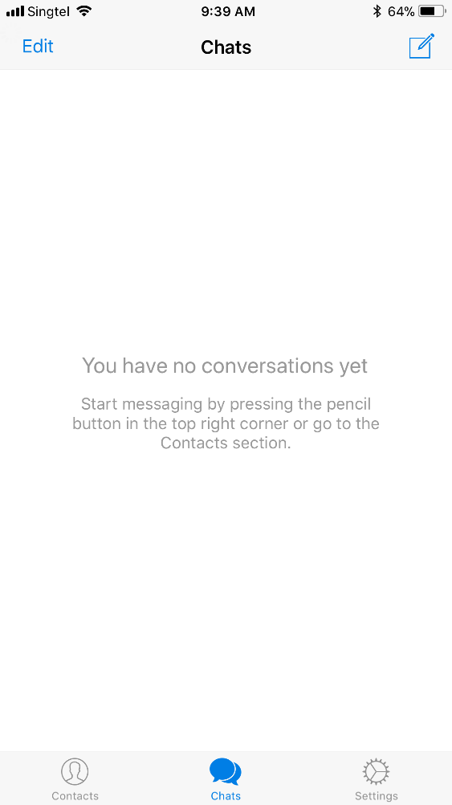
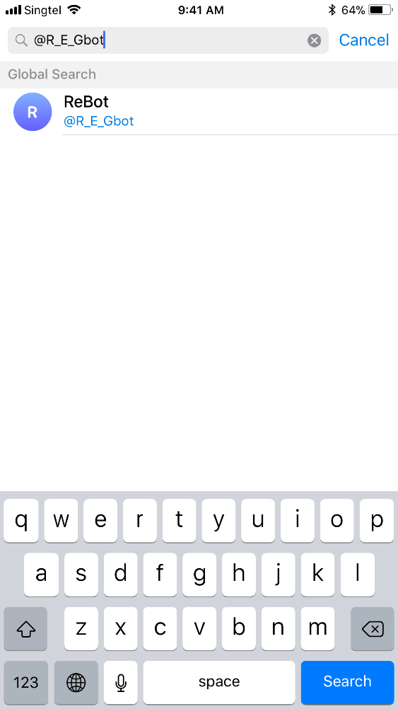
Step 3: Add @ISPVMF_ReBot
Add a Chat
Search for @ISPVMF_Rebot
Select @ISPVMF_Rebot

Slide 27

Rebot
Putting it Together For the First Time
30 minutes

Slide 28
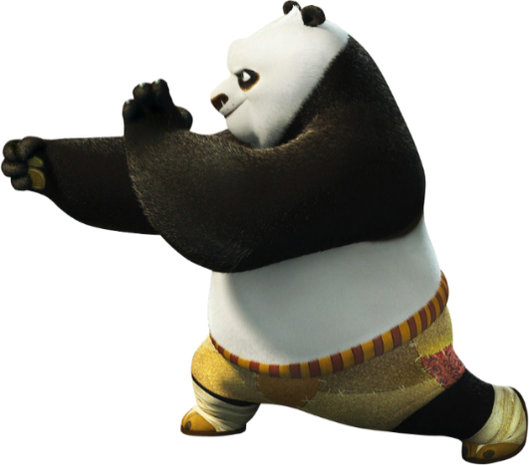

Slide 29
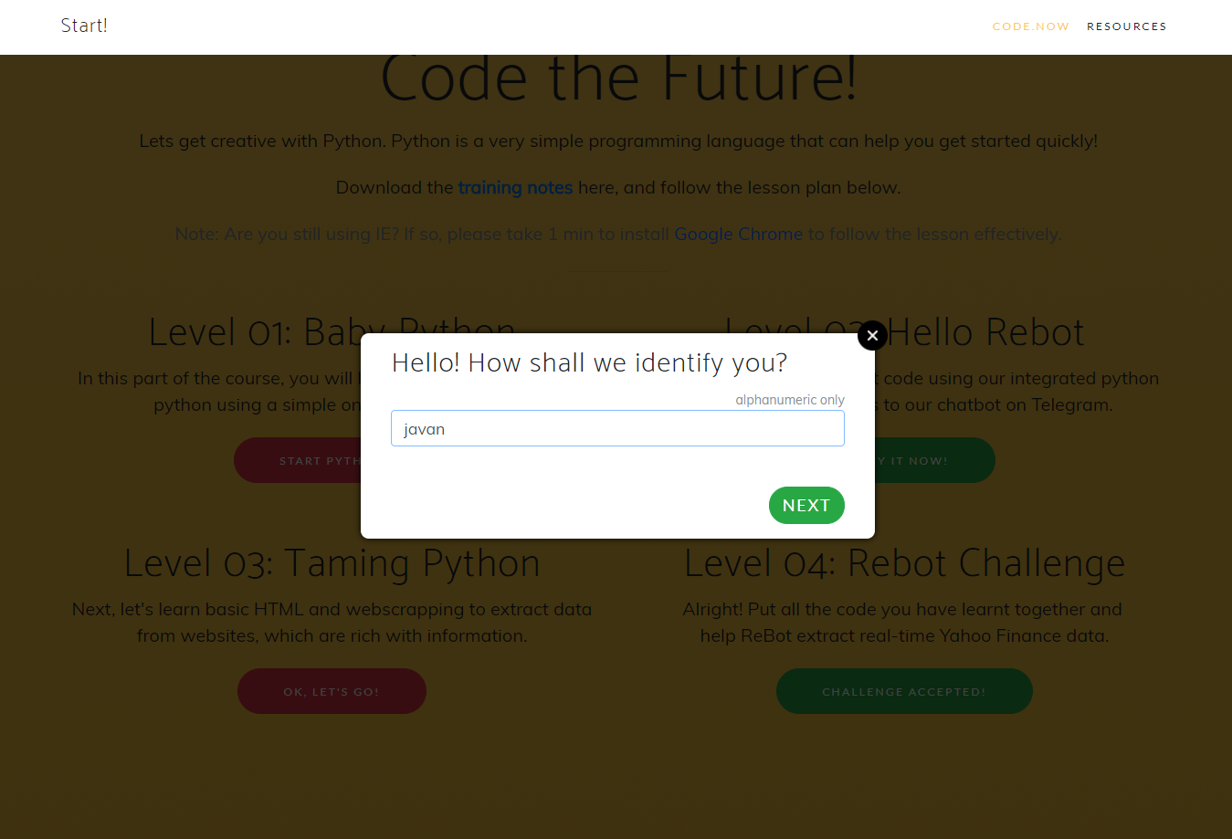
Choose an identity (alphanumeric)
your ntid

Slide 30
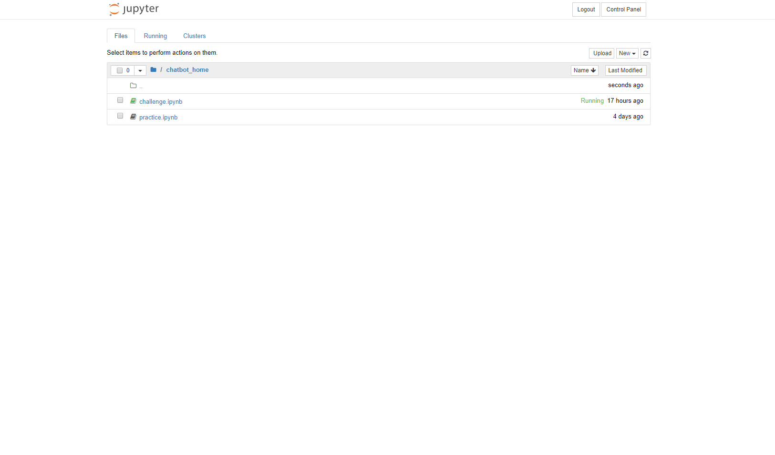
Jupyter: Integrated Python/Rebot
Click on practice.jpynb to start with the tutorial
Jupyter has been integrated
with @ISPVMF_Rebot
on Telegram
Next, lets see how your code changes on Jupyter
appear magically (hopefully) on your mobile phone

Slide 31
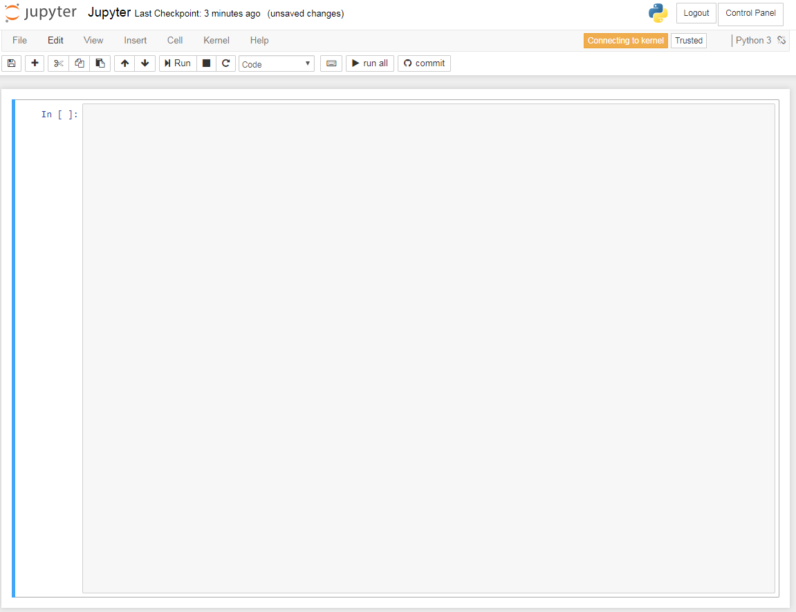
Jupyter: Integrated Python Editor
def send_to_rebot(from_rebot):
message = rebot.createEmptyMessage()
message.addText("hello")
return message
print(send_to_rebot("test"))

Slide 32
Let the Magic Happen
Appetizer
Return “Hello World”
Return “Your Name”
Main Course
Lets make our chat bot smarter.
Return Sum (1 + 1)
Return (IF .. THEN .. ELSE)
Dessert
Return random results.
What is the day today?
What is your name?
I am bored?
Notes:
Give roles – product owner, tester, developer

Slide 33
Web-scraping
Scrape Data From HTML
60 minutes
Notes:
5 min - Opening vid
15 min: Intro & context
40 min: Scratch
30 min: Python
5 min: Code & Algorithms
15 min: Use Cases x2
5 min: Wrap up

Slide 34
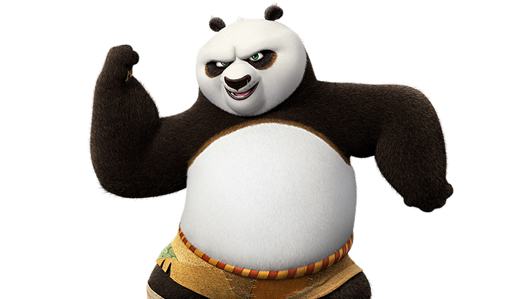

Slide 35

What is HTML?
HTML is
The building block of websites.
Source code of the Web
Concept of HTML Tags
Open tags <HTML>
Close tags </HTML>
Let’s see how to scrape data from HTML
HTML

Slide 36
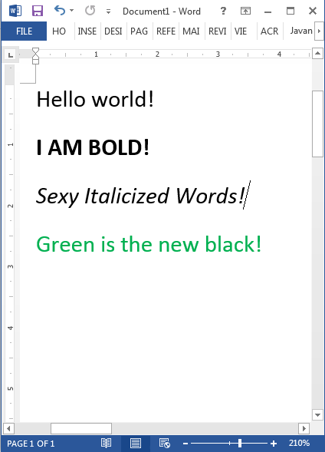
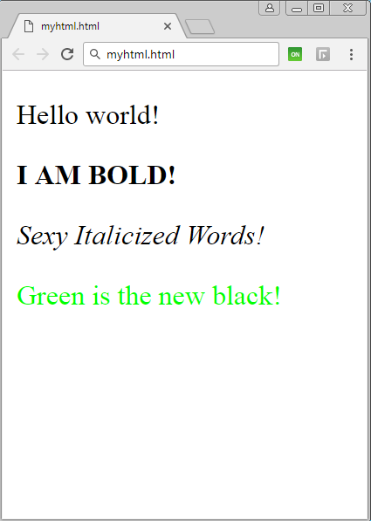
Word Doc vs HTML Doc
Word Document
HTML Document

Slide 37
Word Doc vs HTML Doc
Word Document
HTML Document

Slide 38
HTML - Code Visualization
HTML - NESTED CONTAINERS
HTML - CODE BLOCKS
HTML - RAW CODE
Container (HTML)
<HTML>
</HTML>
<HTML>
<BODY>
<P CLASS=“Text”>
Hello World! </P>
</BODY>
</HTML>
Container (BODY)
<BODY>
</BODY>
Container (P)
<P CLASS=“Text”>
Hello World!
</P>
These values are enclosed in tags (think of containers).
They are the basic building blocks needed used to build basic to complex websites.
Notes:
We are just going to learn some basic tags
Built piecemeal

Slide 39
Word Doc vs HTML Doc
Word Document
HTML Document

Slide 40
Word Doc vs HTML Doc
Hey! HTML is just made up of TAGs
<html>
<body>
<p>
<p>
<p>
<p>
</body>
</html>
</p>
</p>
</p>
</p>
Hello World!
<b>I AM BOLD!</b>
<i>Sexy Italicized Words!</i>
<font color=“green”>Green is the new black!</font>

Slide 41
Think of Tags as Containers
Think of a
HTML TAG
As a
CONTAINER
I AM A VALUE

Slide 42
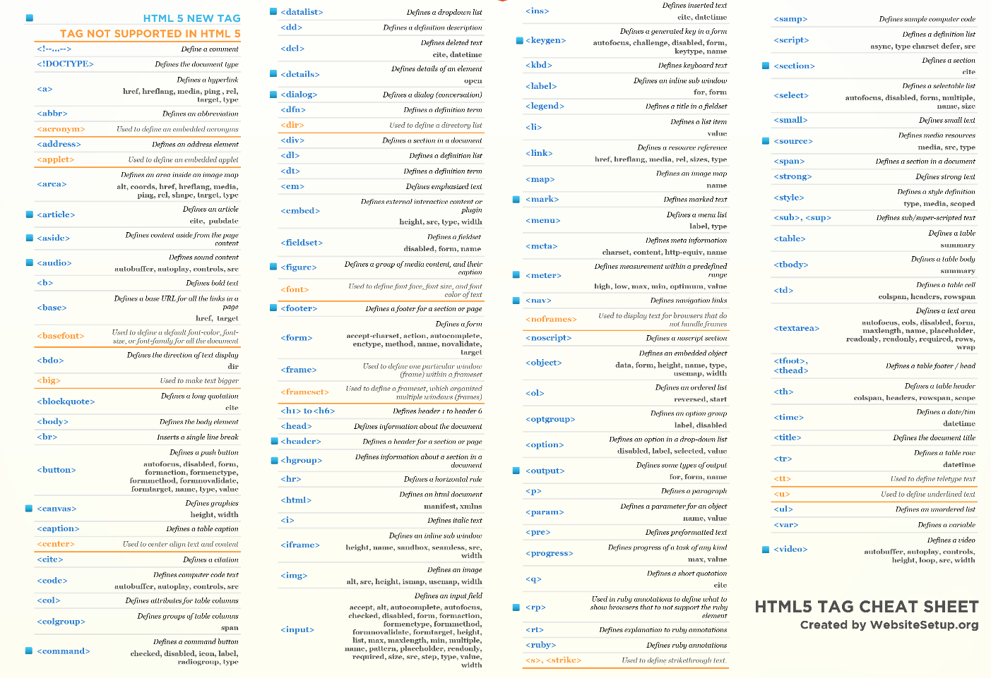
So many types of HTML tags…
For
Illustration Purposes Only

Slide 43
Useful Tags for Today
Never fear! Only need these today.
<html>
<body>
<p>
<span>
<td>
<div>
</html>
</body>
</p>
</span>
</td>
</div>

Slide 44
Notes:
Go back to rebot.chat & click Level 03

Slide 45
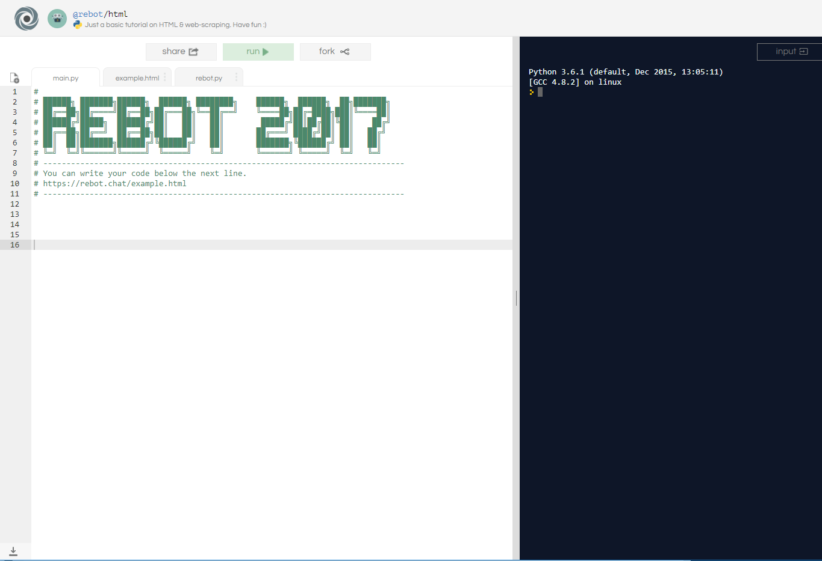
Let’s Give it a Try
Click on “Fork” to make a copy of the tutorial
Notes:
See trainer-guide Level 03

Slide 46
Let’s Give it a Try
You should see three files:
main.py
example.html
rebot.py
Notes:
See trainer-guide Level 03

Slide 47
Let’s Give it a Try
Step 1: Import libraries
Coders in the community can create libraries of commonly used features. These templates are pre-defined and can help us simplify and reuse code.
Step 2: What is the document filename? For example. “Quarterly reporting.doc”, “Mydocument.html”, http://rebot.chat/index.html.
Step 3: Get the raw content within the document
Extract the file content as bytecode literals directly from the document.
Step 4: Format the content into a readable format
Creates a clean HTML format of the raw content, which is then readable by the extraction logic.
Step 5: Find the data-point we need
Use the library to search for the container that we need, including any specific class properties into the search criteria
Notes:
See trainer-guide Level 03

Slide 48
Let’s Give it a Try
# Step 1: Tell python that you want to use rebot library.
import rebot
# Step 2: Keep the filename in a variable (ie. container)
filename = "example.html"
# Step 3: Ask rebot to give you the contents in the file
content = rebot.getContent(filename)
# Step 4: Ask rebot to convert the content to proper HTML
html = rebot.getHtml(content)
# Step 5: Search for the container in the HTML
data = html.search("span", "class", "target")
# Finally! Show the data
print(data)
Notes:
See trainer-guide Level 03

Slide 49
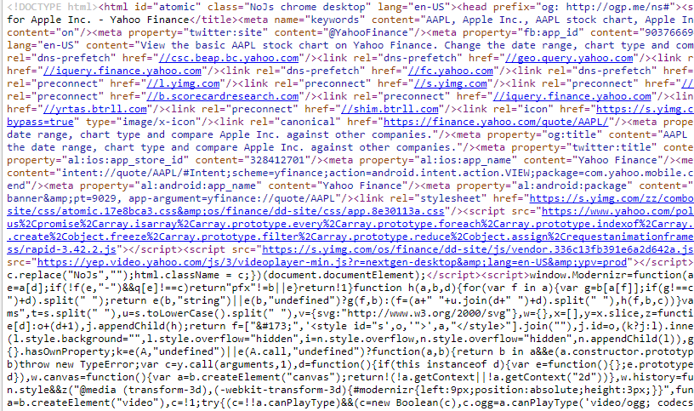
Often, its not so easy..
Example: HTML code behind Yahoo.com
Notes:
Close off the hands-on session.
In reality – its not so easy. Many websites are complex, dynamic and have mixed codes and templates to generate.

Slide 50
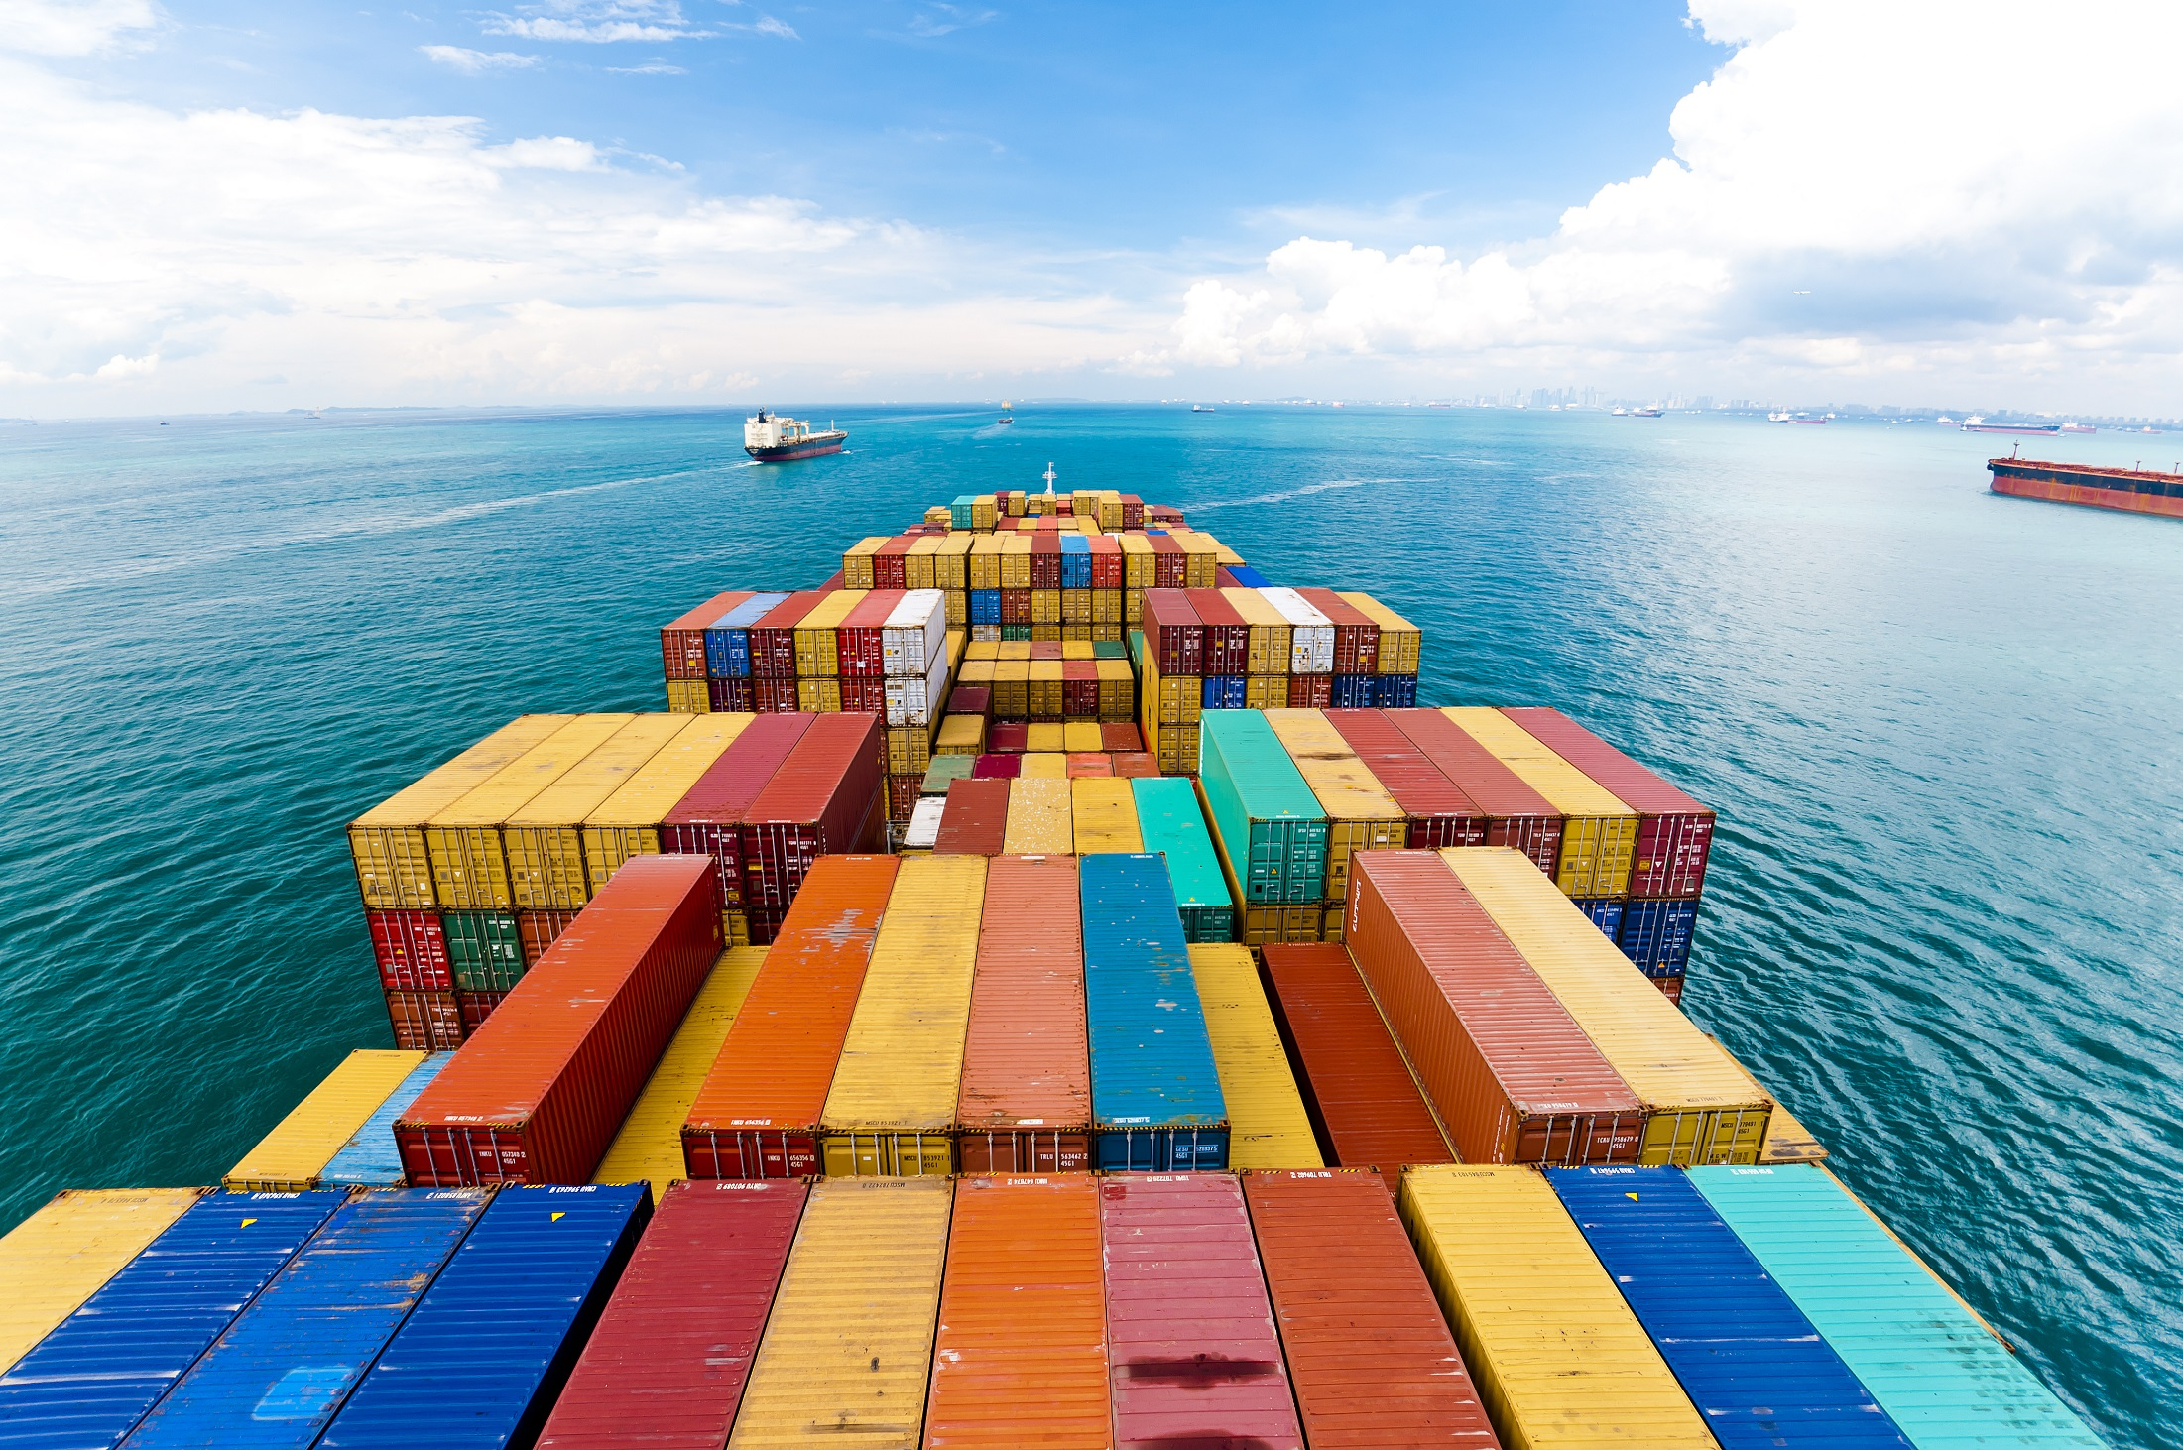
Often, its not so easy..
HOW TO FIND A CONTAINER LIKE DAT?
Notes:
So many containers. How do you find the container that contains the data point that you want.

Slide 51
Nesting of Data
Geography
Websites
Country
Html
City
Body
Town
Table
Street
TD (Table Data)
Block
Span
Notes:
Go back to first-principles.

Slide 52
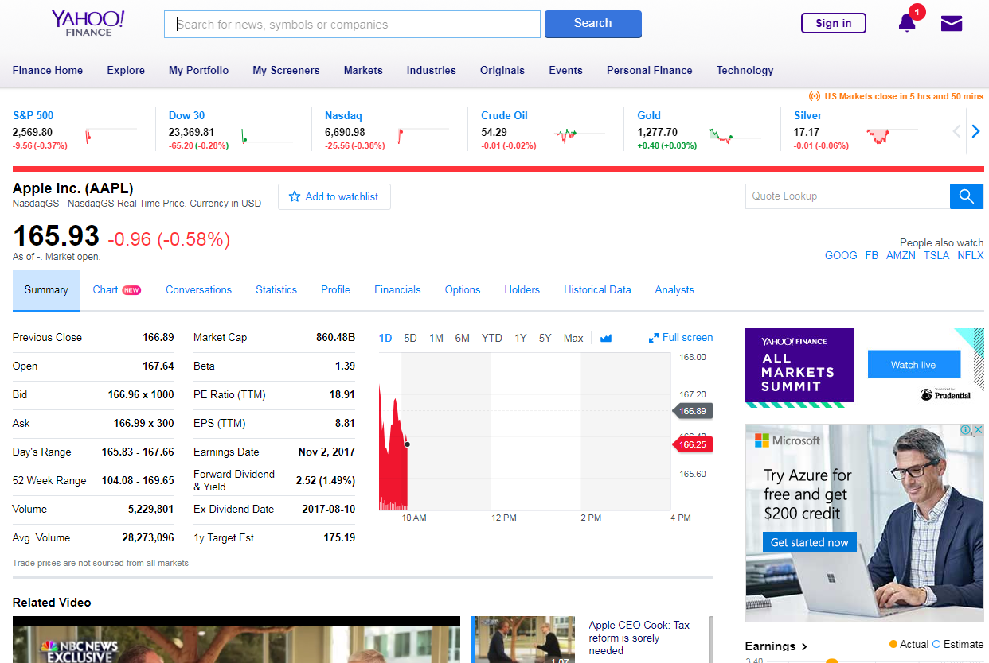
Nesting of Data: Example Yahoo
Notes:
Lets see how a website looks like.

Slide 53
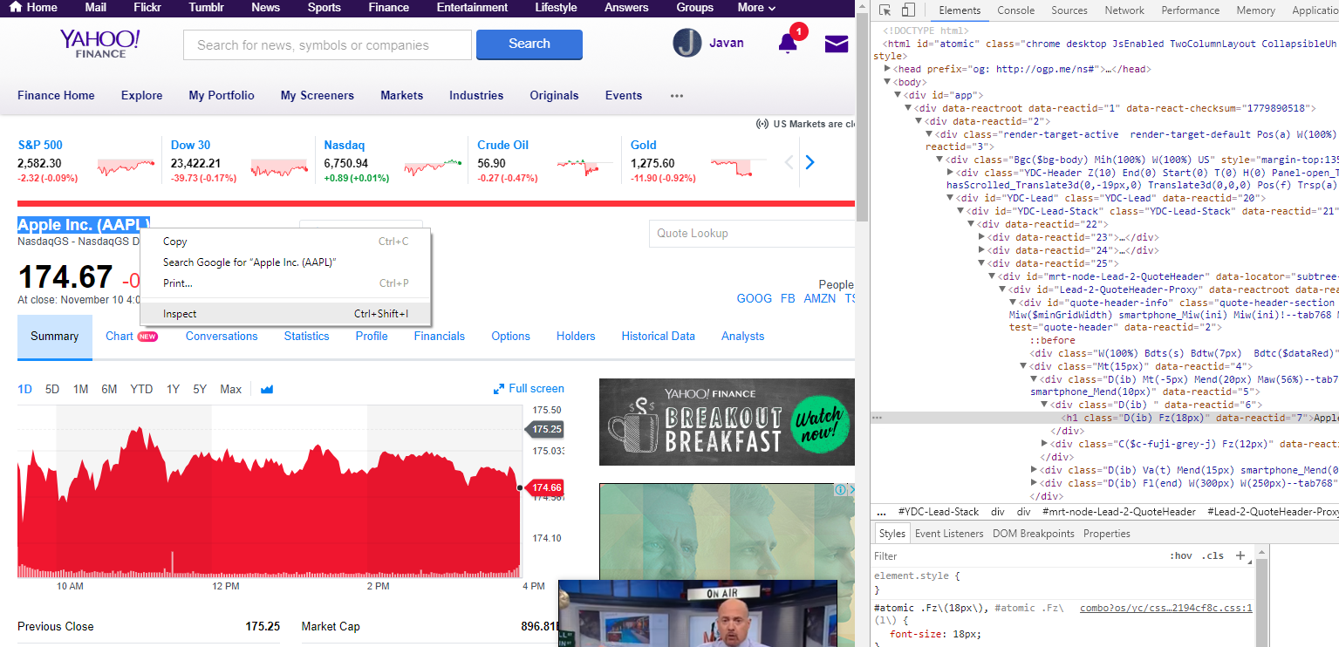
A Big Thank You to Community
Using Google Chrome: Developer Tools
Yahoo Finance – AAPL (Apple Inc)
Select Company Name
Right-click > Inspect
Notes:
Do a short demo of Google developer. Ask them to try it out

Slide 54
Team Challenge
Scraping Real-time Data from Yahoo Finance
90 minutes

Slide 55

Team Challenge Rules!
Earn as many gold coins as possible by completing challenges!
Spend your gold coins effectively to finish your challenges quickly!
*Note: Challenges must be completed in sequence
x 2 : Challenge 1
x 3 : Challenge 2
x 4 : Challenge 3
x 5 : Challenge 4
Free : Use training materials
x 1 : Seeking help from another sub-team
x 2 : Ask facilitators

Slide 56
Prizes
Overall Best Pitch
Best Salesman
Group with the Most Outstanding Pitch
(Decided by Event Judges)
Overall Best Group
Techie Masters
Group with the Most Number of Gold coins
Best Team in the Group
Techie Buddies
Team with the Most Number of Gold coins
Best Participant in the Group
Tech Guru
Most Outstanding Participant in the Group
(Decided by TD Emcees and Game Masters)

Slide 57
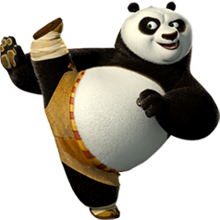

Slide 58
Jupyter: Integrated Python/Rebot
Click on challenge.jpynb to start the challenge!
Teams of 3
Complete challenges in sequence

Slide 59
Hints & Recap
HTML - NESTED CONTAINERS
HTML - CODE BLOCKS
HTML - RAW CODE
Container (HTML)
<HTML>
</HTML>
<HTML>
<BODY>
<P CLASS=“Text”>
Hello World! </P>
</BODY>
</HTML>
Container (BODY)
<BODY>
</BODY>
Container (P)
<P CLASS=“Text”>
Hello World!
</P>
These values are enclosed in tags (think of containers).
They are the basic building blocks needed used to build basic to complex websites.
data = html.search("p", "class", "text")
Notes:
We are just going to learn some basic tags
Built piecemeal

Slide 60
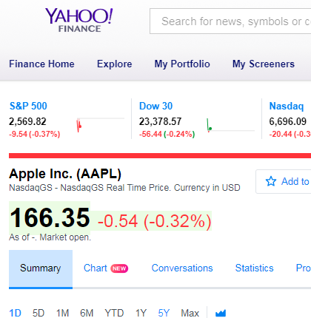
Hint A
<h1
class="D(ib) Fz(18px)"
data-reactid="7">
Apple Inc. (AAPL)
</h1>
Solution:
data = html.search(“h1", "class", "D(ib) Fz(18px)")

Slide 61
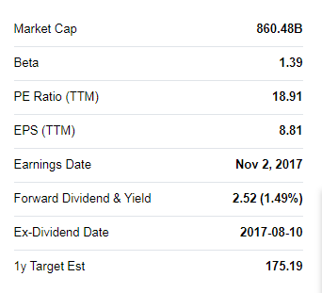
Hint B
<td
class="Ta(end) Fw(b) Lh(14px)"
data-test="BETA-value"
data-reactid="89">
<span
class="Trsdu(0.3s) "
data-reactid="90">
<!-- react-text: 91 -->1.39<!-- /react-text -->
</span>
</td>
Solution:
data = html.search(“h1", “data-test", " BETA-value")

Slide 62
Good Luck!

Slide 63
Team Challenge Round
*Your team must complete challenges in sequence
Challenge 1
Get the following information
Company Name
Ticker Price
Challenge 2
Get the following stock indicators
Beta
PE Ratio (TTM)
EPS (TTM)
Challenge 3
Give a recommendation if the following conditions are satisfied:
Beta >= 1.5 – “RISKY”
Beta < 1.5 – “SAFE”
Challenge 4
Get the latest news headline

Slide 64
Resources

Slide 66
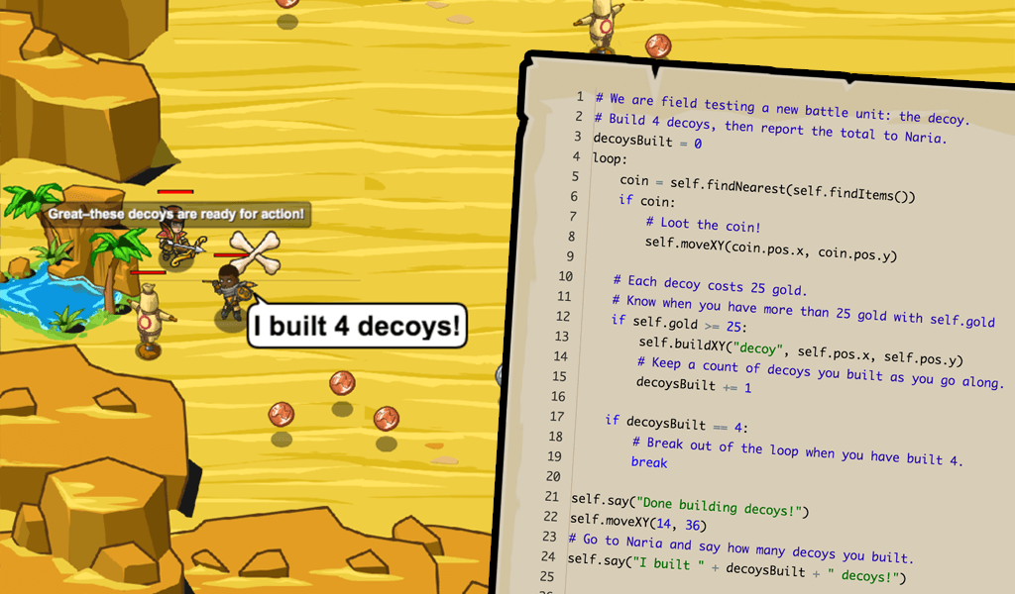
CodeCombat.com
CodeCombat is a fun browser-based coding game that teaches programming. In order to advance through the game's levels, players must prove their knowledge by writing code.

Slide 67
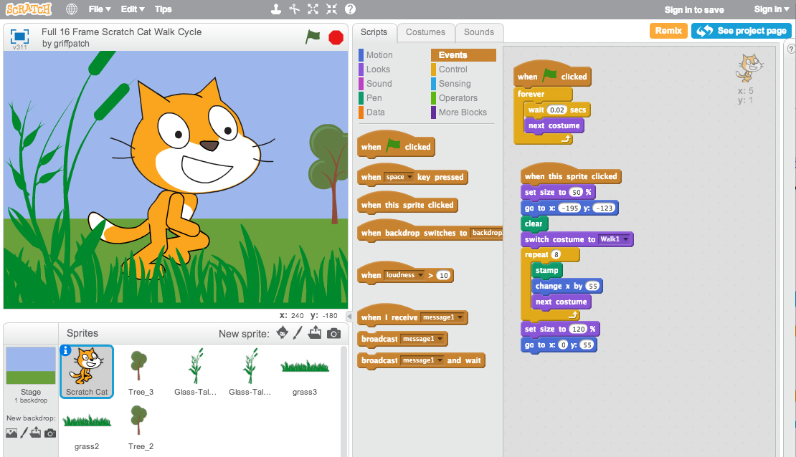
Scratch.mit.edu
Scratch was created by MIT to help people learn to think creatively, reason systematically and work collaboratively. You can use it to create and publish interactive stories, animations, games!

Slide 68
Pitch Perfect

Slide 69

Notes:
Some broad ideas
7 groups of 6 - 10min
Pitch - 3 x 7 mins - 25min
Choose best 2 ideas – 10min

Slide 70
Wifi-Access
SSID
ISPVMF_RETREAT_2017
PASSWORD
ISPVMF_2017

